Slide 1
Sorting Algorithms

Slide 2
Sorting Algorithms
There are different ways to sort a list. Some methods of sorting a list could be faster or slower than others.
The four Sorting algorithms we are going to study are:
Selection sort/ Simple sort
Insertion sort
Bubble sort
Quicksort (Higher Level only)

Slide 3
Selection/Simple Sort
As selection sort basically looks for the smallest item (ascending order) and places it in the first position. It then finds the next smallest item and places it in the second position and so on.
The selection sort iterates from left to right through each list (right to left for descending order). For each list item, the algorithm searches the unsorted section for an element that is less than the current index..
If there is an element smaller than the current index, they are swapped and the algorithm moves onto the next list item.
This is repeated until the algorithm moves onto the last list item.

Slide 4
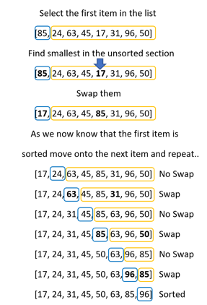

Slide 5
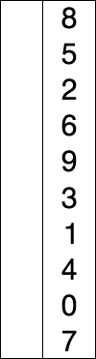
Selection Sort
https://en.wikipedia.org/wiki/Selection_sort#/media/File:Selection-Sort-Animation.gif

Slide 6
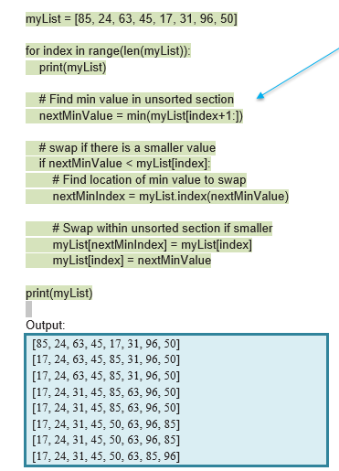
Selection Sort - Python Code
https://repl.it/@suzannelinnane/Selection-Sort

Slide 7
Selection Sort - Python Code
Later on, we will be looking at the running times and efficiency of the algorithms.
When calculating the worst case running time for a selection sort, the min() function is really a loop.
It loops through the unsorted section to find the minimum value.
The following code is an alternative (and more complicated) to using the min() function.
https://repl.it/@suzannelinnane/Selection-Sort-without-min

Slide 8
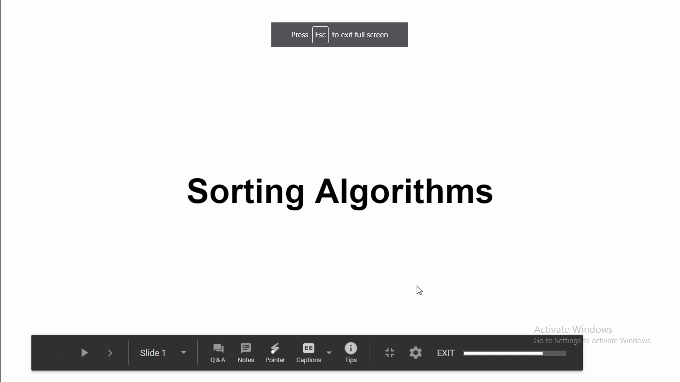

Slide 9
Insertion Sort
An insertion sort is essentially how you might sort a deck of cards. You start with two cards and order these. Then for every new card, you decide where to place this new card within the sorted cards.
A computer cannot visualise the sorted cards like a human, it must iterate from right to left through the sorted cards to determine where the card is inserted.

Slide 10
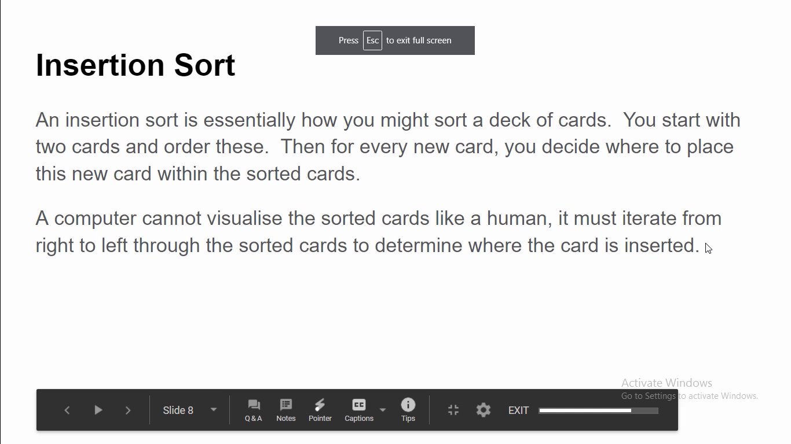

Slide 11
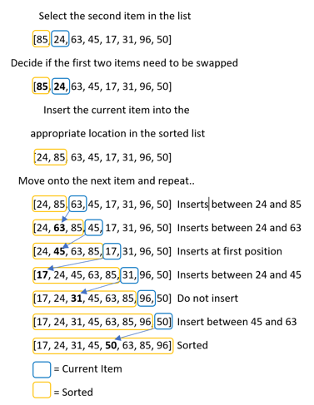
Insertion Sort
The algorithm takes the item outlined in blue and keeps iterating left until it finds it’s ordered position.
Computers cannot see the list as humans do so this algorithm keeps shifting the sorted items up the list (to the right) when they are larger than the item being inserted.

Slide 12

Insertion Sort - Example
https://en.wikipedia.org/wiki/Insertion_sort#/media/File:Insertion-sort-example-300px.gif

Slide 13
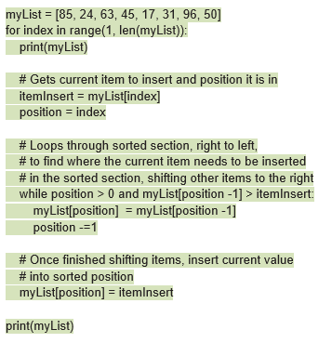
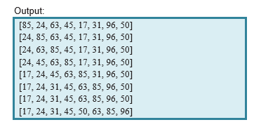
Insertion Sort - Python Code
https://repl.it/@suzannelinnane/Insertion-Sort

Slide 14
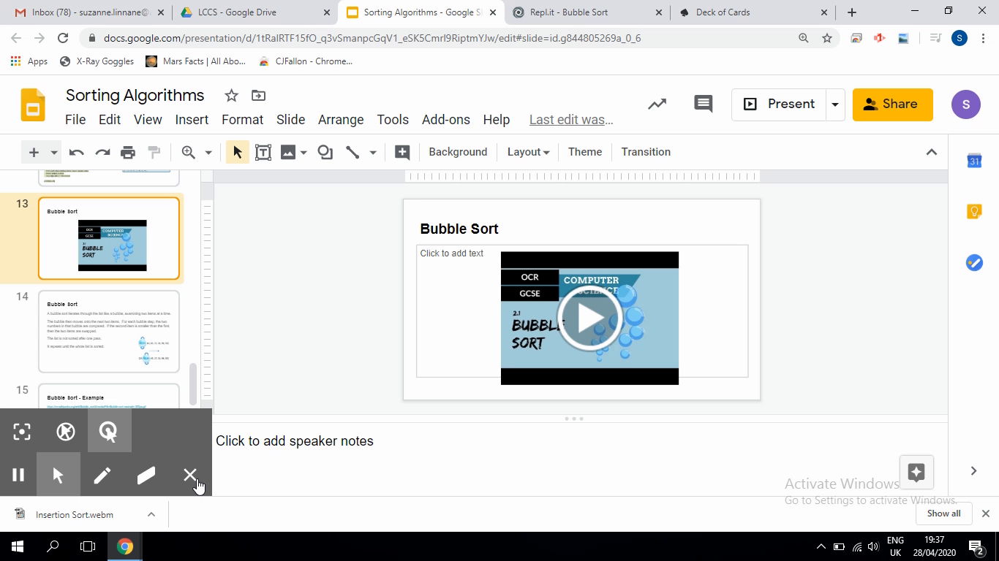
Bubble Sort

Slide 15
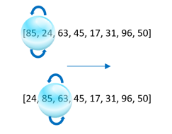
Bubble Sort
A bubble sort iterates through the list like a bubble, examining two items at a time.
The bubble then moves onto the next two items. For each bubble step, the two numbers in that bubble are compared. If the second item is smaller than the first, then the two items are swapped.
The list is not sorted after one pass.
It repeats until the whole list is sorted.

Slide 16

Bubble Sort - Example
https://en.wikipedia.org/wiki/Bubble_sort#/media/File:Bubble-sort-example-300px.gif

Slide 17
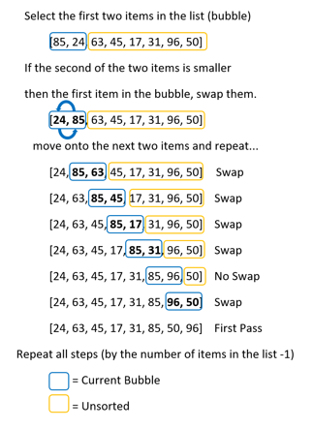
Bubble sort
This shows the first pass of a bubble sort.
You may be lucky where the list is sorted after one pass. But for the worst case, the smallest value may be the last item in the list and several more passes are needed for it to bubble down the list.

Slide 18
Bubble Sort
Therefore we need two loops.
The first outer loop iterates one less than the number of items in the list, which is the number of passes we need in the worst case scenario.
For each outer loop iteration, we have an inner loop (nested loop) which conducts the single bubble sort pass.

Slide 19
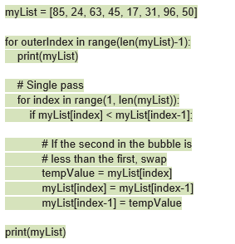
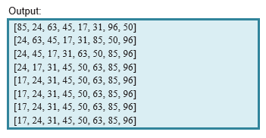
Bubble Sort - Python Code
https://repl.it/@suzannelinnane/Bubble-Sort

Slide 20
Bubble Sort
Advantages:
Easy to implement
Performs well on a small list
Elements are swapped in place without using additional temporary storage, so the space requirement is at a minimum.
Disadvantages:
Does not deal well with a list containing a huge number of items.

Slide 21
Selection/Simple Sort
Advantages:
Performs well on a small list.
In-place sorting algorithm, no additional temporary storage is required beyond what is needed to hold the original list.
Disadvantages:
Not efficient when dealing with a large list of items.
Performance is easily influenced by the initial ordering of the items before the sorting process.

Slide 22
Insertion Sort
Advantages:
Easy to implement
Performs well when dealing with a small list.
In-place sorting algorithm so the space requirement is minimal.
Disadvantages:
Not efficient when dealing with a large list of items.

